Slide 1
Chapter #8 Lecture Slides
Alkenes and Cycloalkenes
Part #2 – Nomenclature of Olefins
08-018
Notes:
This slide deck was prepared to reflect the 2013 update to the IUPAC Blue Book, especially with respect to updated preferences for assigning names to alkenes.
This file was prepared by Paul Bracher at Saint Louis University. Other instructors are welcome to use and/or edit these slides—either with or without attribution. I don’t require acknowledgment, but I fully stand by the contents of this presentation and the value of keep up-to-date with scientific standards.

Slide 2
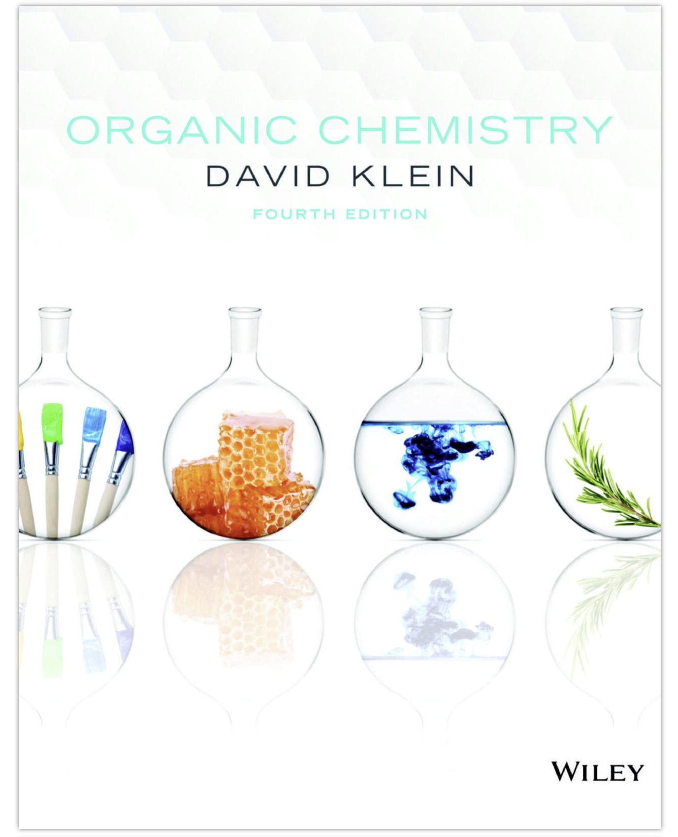
Nomenclature of Alkenes
Our textbook—despite being published in 2021—does not reflect the updated IUPAC guidance from 2013 regarding the systematic nomenclature of olefins.
☹️
a disappointed IUPAC
apparatchik
• Failure to adopt international standards is why Americans still use inches, yards, miles, ounces, and pounds, among other antediluvian units
08-019
Notes:
IUPAC Blue Book (2013) – Includes all the rules, but the writing is almost impenetrable
https://iupac.qmul.ac.uk/BlueBook/
The part of the IUPAC Blue Book that is especially relevant to alkenes and alkynes:
https://iupac.qmul.ac.uk/BlueBook/P3.html
An HTML distillation of the rules for organic nomenclature in the 2013 IUPAC Blue Book:
https://iupac.qmul.ac.uk/BriefGuide/organic.html
Published brief guide:
Pure Appl. Chem. 92(3), 527-539 (2020)
https://doi.org/10.1515/pac-2019-0104
Check the SI in this paper for an even more concise distillation

Slide 3
Nomenclature of Alkenes
2. Alkenes are named based on the longest continuous chain of carbon atoms in the molecule, regardless of whether the chain contains the double bond or not. If the chain includes the C=C bond, replace the –ane suffix from the parent alkane hydrocarbon with –ene.
this is a hexene
this is a hexene
this is a pentane
not a butene
• Note: Klein’s 4th edition (your textbook, published in 2021) perpetuates the outdated rule of selecting the parent chain as the longest chain of carbon atoms that includes the π bond. This used to be the IUPAC preference before 2013.
08-020

Slide 4
Nomenclature of Alkenes
3. When the parent chain includes both carbons in the double bond, number the chain starting from the end that gives the start of the double bond the lower locant number. Insert the locant number directly in front of the –ene suffix.
hex-1-ene
not hex-5-ene
4-ethyl-2,3-dimethylhex-3-ene
not 3-ethyl-4,5-dimethylhex-3-ene
• In case of a tie, apply the nomenclature rules we already know as the tiebreakers:
1. number the chain to give the lower locant to the first substituent (and so on…)
2. number the chain to give the lower locant to the first substituent that comes earliest in the alphabet
• It is not uncommon to encounter the locant for the double bond in front of the name of the parent chain:
1-hexene
2,5-dimethyl-2-hexene
08-021

Slide 5
Nomenclature of Alkenes
4. Notice how we simply incorporate these new rules for alkenes into all the rules of nomenclature we learned for alkanes and alkyl halides.
2,2-difluoro-4-propylhept-3-ene
3-ethyl-8-methylnon-3-ene
not 7-ethyl-2-methylnon-6-ene
(4S)-4-ethyl-5-methylhex-1-ene
not (4S)-4-isopropylhex-1-ene
(2R)-2-bromo-4-ethylhex-3-ene
not (5R)-5-bromo-3-ethylhex-3-ene
08-022

Slide 6
Nomenclature of Alkenes
5. Recall that C=C double bonds in which each olefinic carbon atom is substituted with two different groups can exist as a pair of diastereomers.
6. We differentiate these stereoisomers with E/Z descriptors added as prefixes.
(3E)-3-methylhept-3-ene
(3Z)-3-methylhept-3-ene
• If the higher priority groups (using the Cahn–Ingold–Prelog system) on each carbon atom are on “opposite sides” of the double bond, the descriptor E is used. If the higher priority groups are on the “same side”, the descriptor Z is used.
08-023

Slide 7
Nomenclature of Alkenes
7. In cases where each carbon atom of the C=C bond is only monosubstituted, it is acceptable to use the descriptors cis- and trans-
(2E)-pent-2-ene
trans-pent-2-ene
trans-2-pentene
(2Z)-pent-2-ene
cis-pent-2-ene
cis-2-pentene
(3E)-3,4-dimethylhept-3-ene
not trans-3,4-dimethylhept-3-ene
certainly not cis-3,4-dimethylhept-3-ene
(3Z)-4-bromo-3-methylhept-3-ene
08-024
Notes:
It is not uncommon to see the locant of the stereodescriptor omitted when the feature to which it refers is unambiguous. For instance, (2E)-pent-2-ene could be called simply (E)-pent-2-ene or (E)-2-pentene, because there is only one double bond. With this said, IUPAC prefers that the locant is included for all stereodescriptors.

Slide 8
Nomenclature of Alkenes
8. When the parent chain of an alkene does not include the double bond, it will be included in the name of a substituent of the parent chain.
(6S)-6-(2-methylpent-4-en-2-yl)dodecane
9. Alkene-containing substituents are named as alkenes, except after you identify the longest chain of the substituent, you number it from the end that gives its point of attachment to the parent chain the lower locant number. The substituent name is made by dropping the final –e, then appending the locant of the point of attachment followed by –yl.
a but-3-en-1-yl group
a but-3-en-2-yl group
a but-2-en-2-yl group
a but-1-en-2-yl group
08-025

Slide 9
Nomenclature of Alkenes
10. Groups attached via a double bond to the parent chain are named as ylidenes.
a methylidene group
a butan-1-ylidene group
a butan-2-ylidene group
sometimes seen as its common name: a methylene group
5-(pentan-3-ylidene)decane
08-026
Notes:
I’m not sure where the switchover is with regard to preference for including “an”. For instance, “methylidene” is preferred over “methanylidiene” but “butan-1-ylidene” is preferred over “but-1-ylidiene”. I think “ethylidiene” is preferred over “ethanylidene”.

Slide 10
Nomenclature of Alkenes
11. IUPAC allows common names for some alkenes and alkene-containing substituent groups
ethylene
but ethene preferred
propylene
but propene preferred
vinyl group
but ethenyl preferred
allyl group
but prop-2-en-1-yl preferred
styrene
also vinylbenzene
but ethenylbenzene preferred
4-ethenylheptane preferred
also 4-vinylheptane
not 3-propylhex-1-ene
08-027

Slide 11
Nomenclature of Cycloalkenes
1. Cycloalkenes are compounds with a C=C bond between two carbons in a ring.
2. Cycloalkenes are named by numbering the ring such that the C=C bond is between C1 and C2.
cyclohexene
not cyclohex-1-ene
3,3-dimethylcycloheptene
not 1,1-dimethylcyclohept-2-ene
not 7,7-dimethylcycloheptene
5,5-dichloro-1-methylcyclopentene
not 5,5-dichloromethylcyclopentene
not 1,1-dichloro-2-methylcyclopent-2-ene
• The locant “1” for the position of the C=C bond in a cycloalkene is omitted when alone as it is implied.
08-029

Slide 12
Nomenclature of Cycloalkenes
1. When contained in small rings—fewer than 8 atoms—it is assumed all double bonds are cis- with respect to the ring sides if no E- or Z- descriptor is given.
1-methylcyclobutene
(1Z)-1-methylcyclobutene
1-bromocyclobutene
(1E)-1-methylcyclobutene
Incorporate these rules for cycloalkenes with the other rules for nomenclature we have learned.
methylidenecyclohexane
(1E,4S,8S)-4-chloro-8-methyl-1-(pent-1-en-2-yl)cyclooctene
08-029

Slide 13
Nomenclature of Polyenes and Cyclopolyenes
1. Compounds with multiple C=C double bonds are called polyenes.
2. When multiple C=C bonds appear in the longest chain, replace the –ne suffix from the parent hydrocarbon with –diene (for 2), –triene (for 3), etc.
(3R)-3-methylhexa-1,5-diene
cycloocta-1,3,6-triene
also 1,3,6-cyclooctatriene
not cycloocta-1,4,6-triene
08-030

Slide 14
Nomenclature of Polyenes and Cyclopolyenes
3. If there is a tie for longest chain in a polyene, choose the chain with the most double bonds.
(3S,4E)-3-ethylocta-1,4-diene
not (3S,4E)-3-ethenyloct-4-ene
08-031

Slide 15
Practice Problem: Olefin Nomenclature
Q: Provide a name acceptable to IUPAC for the following compound.
A:
(2R,3E)-2-bromo-4-(2-fluoroethan-1-yl)hept-3-ene
P08-01-01

